Slide 1
Binary Search Tree
Prof. Ramesh Ragala
SCSE, VIT University
Chennai Campus

Slide 2
Introduction to Binary Search Tree
Search Trees are data structure that support many dynamic set operations.
Dynamic Set Operations:
Search, Minimum, Maximum, Predecessor, Successor, Insert and Delete.
Search Tree can be used as
Dictionary
Priority Queue
The time taken by basic Operations on Binary Search Tree is proportional to the height of the tree.
Complete Binary Tree with n-nodes → O(log n)
Linear chain of n-nodes → O(n)

Slide 3
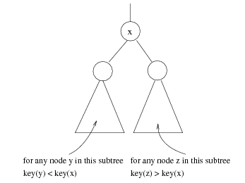
Introduction to Binary Search Tree
Each node associated with key along with data in binary search tree.
BST stores the keys in the nodes in way to so that searching, insertion and deletion can be done efficiently.
Binary Search Tree Property:
Let x be a node in binary search tree. If y is a node in the
left subtree of x, then key[y]≤key[x]. If y is a node in the
right subtree of x, then key[x]≤key[y].
Simply, A binary search tree is a binary tree in which all
nodes in the left subtree of a node have lower values than the node.
All nodes in the right subtree of a node have higher value than the node.
Most Probably, each node in BST contains left, right and p that points
to the nodes corresponding to its left child, its right child and parent
(key is also included)

Slide 4
Introduction to Binary Search Tree
8
5
5
11
4
8
2
7
6
10
18
1
7
11
4
15
20
3
21
BINARY SEARCH TREE
NOT A
BINARY SEARCH TREE

Slide 5
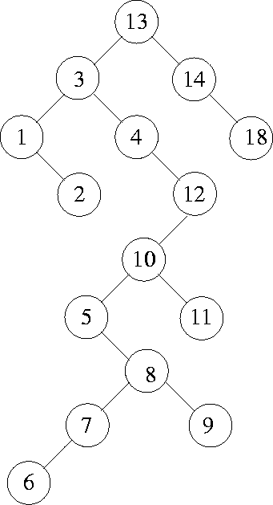
Introduction to Binary Search Tree
Given Set is {13, 3, 4, 12, 14, 10, 5, 1, 8, 2, 7, 9, 11, 6, 18}
Inserting the values from the given set in that order, starting from an empty tree.

Slide 6
Introduction to Binary Search Tree
2
5
3
3
7
7
2
4
8
5
8
4
Two BST representing the same set

Slide 7
Introduction to Binary Search Tree
The Binary Search Tree code → node
typedef struct BST
{
short int key;
Struct node *leftchild;
Struct node *RightChild;
Struct node *parent;
} node;

Slide 8
Introduction to BST
InOrder Tree Walk:
The Binary-Search-tree property allows to print all keys in BST in sorted order using simple recursive algorithm → InOrder Tree walk. (Monotonically increasing order)
The key of the root of subtree is printed between the values in its left subtree and those in its right subtree.
PreOrder Tree Walk:
It prints the root before the values in either subtree.
PostOrder TreeWalk:
It prints the root after the values in its subtree.

Slide 9
Introduction to BST
Procedure to print all elements in BST → InOrder_Tree_Walk(root[T])
It will take O(n) time to walk an n-node binary search tree.
InOrder_Tree_Walk(root)
{
If ( root != NULL) then
{
InOrder_Tree_Walk(leftchild[root]);
Print(key[root])
InOrder_Tree_Walk(rightchild[root]);
}
}

Slide 10
Introduction to BST
BST Operations -- Search :
implements the binary search based on comparison of the items in the tree.
the items in the BST must be comparable (e.g integers, string, etc.)
The search starts at the root. It probes down, comparing the values in each node with the target, till it finds the first item equal to the target. Returns this item or null if there is none.

Slide 11
Introduction to BST
BST Operations -- Search :
Procedure for the BST Search Operation:
if the tree is empty
return NULL
else if the item in the node equals the target
return the node value
else if the item in the node is greater than the target
return the result of searching the left subtree
else if the item in the node is smaller than the target
return the result of searching the right subtree

Slide 12
Introduction to BST
BST Operations -- Search :
Procedure for the BST Search Operation:
Running time of TREE_SEARCH() is O(h) → h is height of the tree.
TREE_SEARCH(x,k)
// pointer to the root of the tree and a key k
{
if(x == NULL or k = key[x]) then
return x;
if ( k < key[x] ) then
return ( TREE_SEARCH(leftchild[x],k);
else
return ( TREE_SEARCH(rightchild[x],k);
}

Slide 13
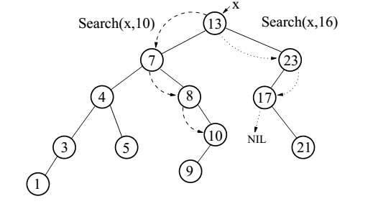
Introduction to BST
Operation: Searching
Example on Searching

Slide 14
Introduction to BST
Operation: Finding the minimum key element in the BST.
According the Binary-Search-Tree Property, the minimum key element is always at the leftmost child in BST.
Pseudo code to return a pointer to minimum element in the sub tree rooted at a given node –x
Run time → O(h)
TREE_MINIMUM(x)
{
while(leftchild[x] != NULL) do
{
x ← leftchild[x];
}
return x;
}
56
26
200
18
28
190
213
12
24
27
Iterative tree search is more efficient but recursive tree search is straightforward

Slide 15
Introduction to BST
Operation: Finding the maximum key element in the BST.
According the Binary-Search-Tree Property, the maximum key element is always at the rightmost child in BST.
Pseudo code to return a pointer to maximum element in the sub tree rooted at a given node – x
Run time → O(h)
56
TREE_MAXIMUM(x)
{
while(rightchild[x] != NULL) do
{
x ← rightchild[x];
}
return x;
}
26
200
18
28
190
213
12
24
27

Slide 16
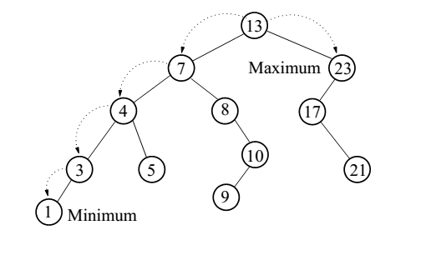
Introduction to BST
Example on Finding Maximum and Minimum in BST

Slide 17
Introduction to BST
Operations: Predecessor and Successor (InOrder Tree Walk)
Successor of node x is the node y such that key[y] is the smallest key greater than key[x].
The successor of the largest key is NIL.
Search consists of two cases. (To find the successor – y of a node – x )
If node x has a non-empty right subtree, then x’s successor is the minimum in the right subtree of x.
If node x has an empty right subtree, then:
As long as we move to the left up the tree (move up through right children), we are visiting smaller keys.
x’s successor y is the node that x is the predecessor of (x is the maximum in y’s left subtree).
In other words, x’s successor y, is the lowest ancestor of x whose left child is also an ancestor of x.

Slide 18
Introduction to BST
Operation: Predecessor and Successor (InOrder Tree Walk).
The successor of the node with key 28 is the node with key 56.
TREE_SUCCESSOR(x)
{
if(rightchild [x] != NULL) then
return( TREE_MINIMUM(rightchild[x]);
y← p[x];
while(y!=NULL and x = right[y])do
{
x ← y;
y ← p[y];
}
return y;
56
26
200
18
28
190
213
12
24
27
O(h)

Slide 19
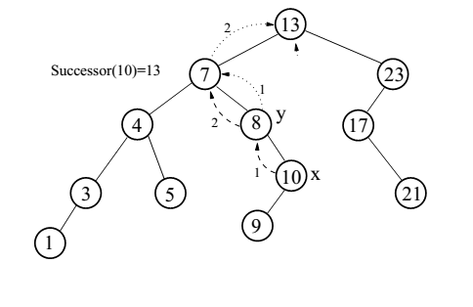
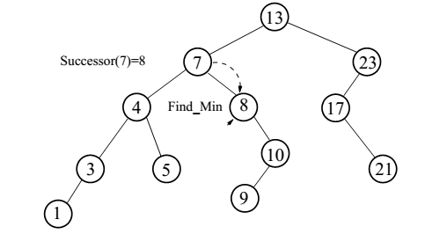
Introduction to BST
Operation: Successor
Example on Successor

Slide 20
Introduction to BST
Operation: Inserting new element in BST
places a new item near the frontier of the BST while retaining its organization of data:
starting at the root it probes down the tree till it finds a node whose left or right pointer is empty and is a logical place for the new value
uses a binary search to locate the insertion point
is based on comparisons of the new item and values of nodes in the BST
Elements in nodes must be comparable!

Slide 21
Introduction to BST
Operation: Inserting new element in BST
Case – 1: The Tree is Empty
Set the root to a new node containing the item
Case – 2: The Tree is not Empty
Calls the recursive helper method to insert the item
10 > 7
10 > 9
10
7
5
9
4
6
8
10

Slide 22
Introduction to BST
Tree-Insert(T, z)
y ← NIL
x ← root[T]
while x ≠ NIL
do y ← x
if key[z] < key[x]
then x ← left[x]
else x ← right[x]
p[z] ← y
if y = NIL
then root[t] ← z
else if key[z] < key[y]
then left[y] ← z
else right[y] ← z
Operation: Inserting new item in BST
Procedure for inserting new item in BST
if tree is empty
create a root node with the new key
else
compare key with the top node
if key = node key
replace the node with the new value
else if key > node key
compare key with the right subtree:
if subtree is empty create a leaf node
else add key in right subtree
else key < node key
compare key with the left subtree:
if the subtree is empty create a leaf node
else add key to the left subtree

Slide 23
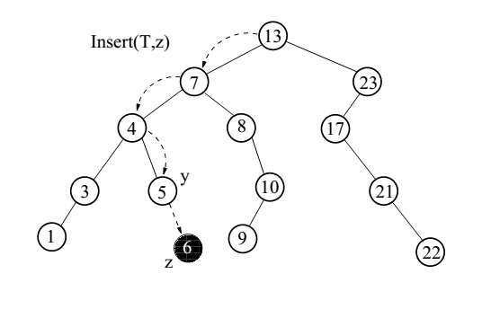
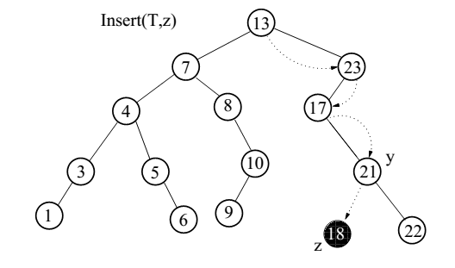
Introduction to BST
Operation: Inserting an Element in BST
Example on Inserting an element in BST

Slide 24
Introduction to BST
Operation: Deleting an element from BST
It is difficult operation in BST
There are Three cases:
If node – x has no children, just delete it
If node – x has one child, splice out node – x . That is, link node – x’s parent and child.
If node – x has two children, splice out node –x successor node – y and replace the contents of the node –x with the contents of node – y.

Slide 25
Introduction to BST
Operation: Deletion in BST
Procedure to Delete an element in BST
if x has no children ♦ case 0
then remove x
if x has one child ♦ case 1
then make p[x] point to child
if x has two children (subtrees) ♦ case 2
then swap x with its successor
perform case 0 or case 1 to delete it
⇒ TOTAL: O(h) time to delete a node

Slide 26
Introduction to BST
Operation: Deletion in BST
Pseudo code to Splice out:
Tree-Delete(T, z)
/* Determine which node to splice out: either z or z’s successor. */
if left[z] = NIL or right[z] = NIL
then y ← z
else y ← Tree-Successor[z]
/* Set x to a non-NIL child of x, or to NIL if y has no children. */
if left[y] ≠ NIL
then x ← left[y]
else x ← right[y]
/* y is removed from the tree by manipulating pointers of p[y] and x */
if x ≠ NIL
then p[x] ← p[y]

Slide 27
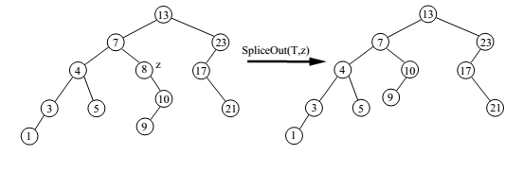
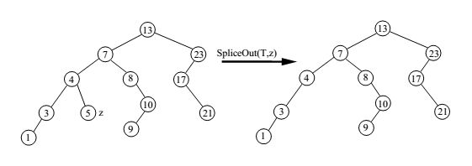
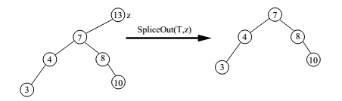
Introduction to BST
Operation: Deletion in BST
Examples in Splice Out:

Slide 28
Introduction to BST
Operation: Deletion in BST
Pseudo code to Deletion:
Tree-Delete(T, z)
if p[y] = NIL
then root[T] ← x
else if y ← left[p[i]]
then left[p[y]] ← x
else right[p[y]] ← x
/* If z’s successor was spliced out, copy its data into z */
if y ≠ z
then key[z] ← key[y]
copy y’s satellite data into z.
return y

Slide 29
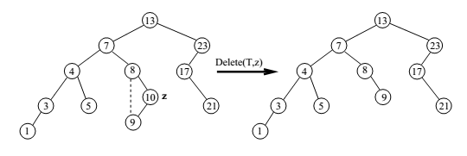
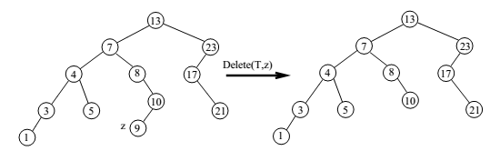
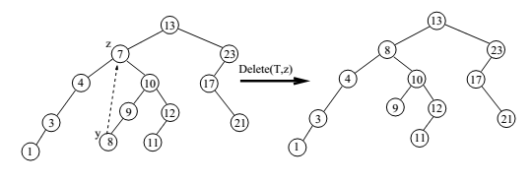
Introduction to BST

